Slide 1

Introduction to Cloud Computing
Week 6
Popular Cloud Services &
Azure Cloud Compute Services
CS-4037
Muhammad Sudais
muhammad.sudais.v@nu.edu.pk

Slide 2
CHAPTER 20 Popular Cloud Services
|Cloud Computing

Slide 3
Popular Cloud Services Overview
Cloud Computing as a Utility:
Long-desired in the computing field.
Became possible after overcoming technological constraints.
Rapid Growth: In the last decade, many vendors like Microsoft, Amazon, and Google offer cloud services.
Advantages: Cost-effective, scalable, enterprise-quality resources, and improved business productivity.
Focus: Infrastructure-as-a-Service (IaaS), Platform-as-a-Service (PaaS), and Software-as-a-Service (SaaS).

Slide 4
Amazon Web Services (AWS)
Overview:
Amazon is a market leader in IaaS.
AWS is built on SOA standards and uses open-source OS and app servers.
Key Offerings:
Compute: EC2 (Elastic Compute Cloud).
Storage: S3 and Elastic Block Store (EBS).
Database: RDS, DynamoDB, SimpleDB.
Networking: CloudFront (CDN).

Slide 5
AWS Elastic Compute Cloud (EC2)
Launch virtual servers in the cloud.
Supports multiple operating systems (Windows, Linux).
Runs on Xen hypervisor.
Users can launch and configure servers as required.

Slide 6
AWS Storage Systems
Storage Types:
Temporal Storage: Non-persistent and exists only while the machine is running.
Persistent Storage: Provided through Amazon EBS or S3.
Chosen based on application needs.

Slide 7
AWS Elastic Beanstalk
PaaS Offering: Simplifies app development.
Supports popular languages like .NET, Java, Python, etc.
Manages load balancing, scaling, and provisioning automatically.
Ideal for web app deployment.

Slide 8
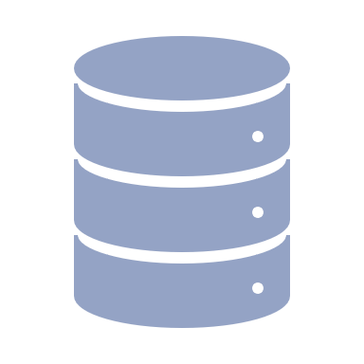
AWS Database Services
Database-as-a-Service (DBaaS):
Relational: Amazon RDS.
NoSQL: DynamoDB and SimpleDB.
Fully-managed by Amazon.
Custom Databases: Can also install custom DBMS on EC2 with EBS storage.

Slide 9
AWS CloudFront and SQS
CloudFront:
CDN for content delivery with low latency.
Uses Amazon’s global edge network.
SQS:
Fully-managed message simple queuing service.
Scalable and used for distributed applications.

Slide 10
Microsoft Azure
Overview:
Offers IaaS and PaaS combined.
Built on Microsoft’s Fabric Controller.
Integrates well with traditional Microsoft software like .NET Framework, SQL Server, etc.
Key Offerings: Azure Virtual Machine, Azure Storage, SQL Azure, and more.

Slide 11
Microsoft Azure Virtual Machine and Platform
Azure Virtual Machine:
Scalable virtual machines managed by Fabric Controller.
Azure Platform:
PaaS and IaaS integrated.
.NET Framework for Windows-based apps.
Supports SQL Server, SharePoint, Dynamics CRM.

Slide 12
Microsoft Azure Storage
Persistent Storage: Independent from VMs.
Services: Blob, Table, Queue, File storage.
Blob: For files.
Table: Non-relational data.
Queue: Message communication between components.
File: Traditional Windows file storage.

Slide 13
Microsoft SaaS and CDN
Azure CDN:
Efficient delivery of high-bandwidth content.
Caches content for high performance.
SaaS Offerings:
Office suite, OneDrive, and others.
Not bundled with Azure, available separately.

Slide 14
Google Cloud Services
Overview:
Google is a leader in cloud computing.
Global data centers support various web-based applications.
Key Offerings:
Compute Engine, Cloud Storage, App Engine, BigQuery, Firebase.
Categories: Compute, Storage, Networking, Databases, Services, and Management.

Slide 15
Google Cloud IaaS and PaaS
IaaS:
Google Compute Engine: Infrastructure for VMs.
Google Cloud Storage: Scalable storage.
PaaS:
Google App Engine (GAE): Platform for developers to build apps.

Slide 16
Google SaaS Offerings
Popular SaaS Services:
Google Docs: Word processing.
Gmail: Email service.
Google Calendar: Scheduling service.
Offered under G Suite (now Google Workspace).

Slide 17
Comparison: AWS, Azure, Google Cloud
AWS:
Leader in IaaS.
Focus on flexibility and services like EC2, S3.
Azure:
Strong integration with Microsoft ecosystem.
PaaS and IaaS combined.
Google Cloud:
Competitive in services like machine learning (TensorFlow), and big data (BigQuery).
Global network for fast content delivery.

Slide 18
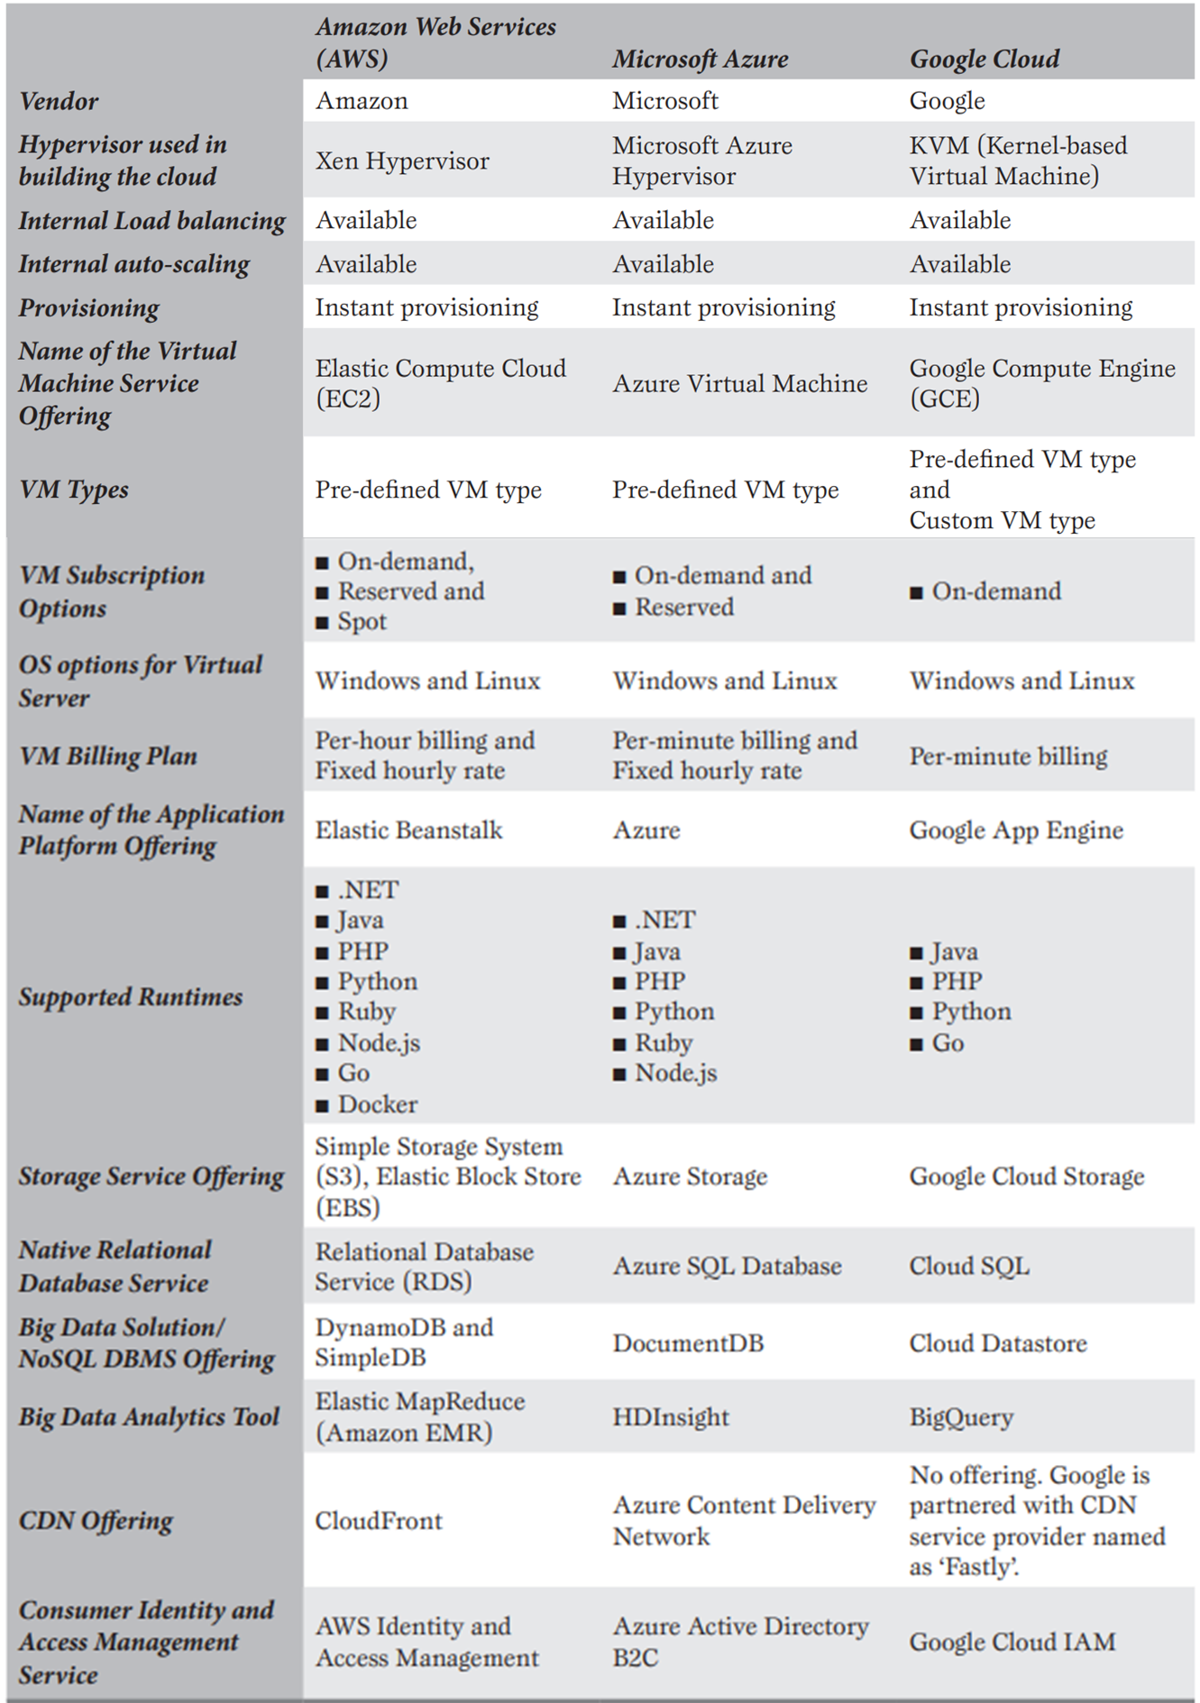
Comparison: AWS, Azure, Google Cloud

Slide 19
CHAPTER 3 Microsoft Azure Cloud Compute Services
|LEARNING MICROSOFT AZURE

Slide 20
Introduction to Azure Compute Services
Overview of Microsoft Azure: A leading cloud provider offering a wide array of cloud services for businesses.
Azure Compute Services: Empower organizations to run workloads in the cloud with scalable and flexible compute resources.
Key Use Cases:
Application migration from on-premises to cloud
Containerization to run apps in isolated environments
Modernization of legacy systems using cloud-native services

Slide 21
What is Azure Compute?
On-demand Computing Resources:
Virtual Disks: High-capacity storage that can be attached to VMs.
Memory and Processors: Scalable resources to handle varying workloads.
Networking: Private and public networking solutions to connect resources securely.
Flexible Pricing Models:
Pay-as-you-go: Pay only for the resources you use.
Reserved Instances: Lock in lower prices for longer commitments.
Rapid Deployment: Cloud computing services can be provisioned in minutes, reducing infrastructure setup time.

Slide 22
Key Azure Compute Services
Azure Virtual Machines (VMs): Traditional IaaS model offering full control over OS and infrastructure.
Azure VM Scale Sets: Autoscaling feature that enables the creation of thousands of identical VMs to meet demand.
Azure App Services: PaaS offering for building and hosting web apps, APIs, and mobile backends without managing infrastructure.
Azure Container Apps: Lightweight, cloud-native applications that run in containers, making them portable and scalable.
Azure Functions: Serverless compute for event-driven workloads, automatically scaling based on demand.
Azure Kubernetes Service (AKS): Managed container orchestration for running Kubernetes clusters in the cloud.

Slide 23
Azure Compute Benefits
Fully Managed Systems: Reduce operational overhead with Microsoft managing infrastructure.
Better Security: Built-in security controls, compliance certifications, and access management.
Innovation & Rapid Development: Scale up or down quickly, enabling teams to innovate without waiting for hardware procurement.
Cost Savings: Avoid upfront capital expenses for physical infrastructure and pay only for what you use.
Hybrid and On-Premises Support: Connect existing on-premises resources to Azure for hybrid cloud solutions.

Slide 24
Azure Virtual Machines
Full Infrastructure Control: Ideal for organizations that want complete control over their infrastructure, including OS management.
OS Support:
Windows: Full range of Windows Server versions.
Linux: Popular distributions like Ubuntu, CentOS, and RedHat.
Use Cases:
Lift-and-Shift Migration: Easily migrate on-premises applications to the cloud.
DevOps Integration: VMs can be used as DevOps agents in CI/CD pipelines.
Testing Environments: Create isolated VMs for development and testing purposes.

Slide 25
Azure VM Scale Sets
Autoscaling & Load-Balancing: Automatically increase or decrease the number of VMs based on demand.
Quick Provisioning: Deploy thousands of VMs in minutes, ideal for handling burst workloads.
No Pre-Provisioning Required: VMs are dynamically created and deallocated as needed, reducing costs.
Big Data & Containerized Workloads: Scale sets are ideal for handling large datasets and running container-based applications.
Use Cases:
CI/CD Pipelines: Scale sets can be used as agents for build and release pipelines in Azure DevOps.
High-Demand Workloads: Deploy scalable instances for handling heavy traffic and computational needs.

Slide 26
Scaling in Azure VMSS
Horizontal Scaling:
Add or remove VMs from a scale set to handle varying loads.
Ideal for applications where adding more instances increases performance (e.g., web apps, services).
Vertical Scaling:
Add more CPU, memory, or storage to existing VMs to handle increased load.
Suitable for scenarios where individual VM performance needs to be enhanced.
Manual & Autoscaling:
Azure VMSS supports both manual and automatic scaling, giving flexibility for both planned and unplanned workload spikes.

Slide 27
Cloud Migration & Lift-and-Shift
Lift-and-Shift:
Minimal Code Refactoring: Move existing applications to Azure with minimal changes.
Faster Migration: Transition applications to the cloud quickly without redesigning them.
Cost Efficiency: Reduces costs associated with maintaining physical infrastructure.
Hybrid Deployment: Combine on-premises and cloud resources for better scalability and redundancy.

Slide 28
Important Considerations for Azure VMs
Networking:
Use Azure VNets to ensure secure connections between VMs and other cloud resources.
VNets enable private, secure communication between Azure resources.
VM Sizing:
Select appropriate VM sizes based on your workload (compute, memory, storage needs).
Storage:
VMs use virtual hard disks (VHDs), including OS disks and temporary storage.
Select the correct disk performance (Standard, Premium) based on your requirements.
Operating System:
Choose between various Windows or Linux images available in Azure.
The cost of VMs includes the OS license, which affects the pricing model.

Slide 29
Azure Hybrid Benefit & Spot VMs
Azure Hybrid Benefit:
Allows organizations to use their on-premises Windows Server and SQL Server licenses on Azure VMs, reducing costs.
Useful for companies with existing Software Assurance licenses.
Savings Calculator: Estimate the cost savings of using Azure Hybrid Benefit for workloads.
Azure Spot VMs:
Take advantage of unused Azure capacity at a lower cost.
Spot VMs can be deallocated when Azure needs capacity for other workloads, making them ideal for fault-tolerant applications like batch jobs.

Slide 30
Azure App Service: A Platform as a Service (PaaS)
Azure App Service is a fully managed PaaS offering that enables developers to build, deploy, and scale web apps, mobile backends, and APIs in an enterprise-grade environment.
Provides built-in infrastructure management (including security patching and load balancing).
No need to manage physical servers, virtual machines, or networks.
Use Cases: Enterprise applications, mobile backends, microservices, RESTful APIs, and more.

Slide 31
Benefits of Azure App Service Over Traditional Hosting
Rapid Deployment: Supports continuous deployment with GitHub, Azure DevOps, and Bitbucket.
Cost-Effective: Pay-as-you-go pricing models to optimize costs.
Seamless Scaling: Automatically scale up or down based on demand.
Managed Infrastructure: Eliminates the need for managing physical infrastructure, reducing overhead.

Slide 32
Key Features of Azure App Service
Language and Framework Support: Supports .NET, Java, Node.js, PHP, Python, Ruby, and Docker.
Environment Flexibility: Easily deploy applications in containers using Docker or integrate with Azure Kubernetes Service (AKS).
Auto-Patching and Load Balancing: Automatic OS and framework patching to secure apps and prevent downtime.
Global Deployment: Easily deploy your app globally for better availability using Azure’s global data centers.
Integrated Monitoring: Use Azure Monitor and Application Insights for diagnostics and performance tracking.

Slide 33

Continuous Integration & Deployment with Azure App Service
CI/CD Integration: Integrate with popular CI/CD tools like GitHub, Bitbucket, Azure DevOps, and Jenkins for automated build and deployment pipelines.
Container Support: Deploy Docker containers directly to Azure App Service or use Docker Compose for multi-container apps.
Zero Downtime Deployment: Use deployment slots to create staging environments and swap without downtime.
Git-based Deployment: Directly push code to Azure App Service via Git to deploy and manage updates.

Slide 34
Scaling and Load Balancing
Automatic Scaling: Scale applications based on predefined rules, traffic loads, or resource consumption (CPU/memory usage).
Horizontal Scaling: Scale out to multiple instances to distribute traffic.
Vertical Scaling: Scale up by increasing the size of the VMs supporting your app (use larger VMs for intensive workloads).
Global Load Balancing: Built-in load balancing across multiple regions for high availability.
Scaling Plans: Available across different pricing tiers, from basic to premium.

Slide 35
High Availability and Disaster Recovery
Uptime SLA: Azure guarantees a 99.95% uptime SLA for App Service.
Geo-Redundancy: Deploy applications across multiple regions for geo-redundancy and failover.
Backup and Restore: Schedule regular backups of your application data and restore from any point.
Disaster Recovery: Use disaster recovery plans for critical applications with hot, cold, or warm failover strategies.

Slide 36
Security and Compliance
Built-in Security Features:
SSL certificates: Free and managed SSL for your custom domains.
DDoS Protection: Azure’s infrastructure provides automatic protection against Distributed Denial of Service (DDoS) attacks.
IP Address Restrictions: Configure IP restrictions to allow or block traffic.
Identity and Access Control:
Integration with Microsoft Entra ID for secure authentication (OAuth, SAML, OpenID Connect).
Managed identities: Use built-in managed service identities to access Azure resources securely.
Compliance Certifications:
Meets multiple global compliance standards, including HIPAA, GDPR, ISO, and SOC.

Slide 37
Networking Features
Connect
Hybrid Connections: Securely connect your Azure apps to on-premise resources, databases, or VMs without complex VPN configurations.
Integrate
Virtual Network (VNet) Integration: Integrate your app with an Azure VNet for secure private network access.
Secure
Private Endpoints: Secure access to your app service with private endpoints, keeping traffic within the Azure network.

Slide 38
Azure Web App for Containers
Custom Docker Images: Deploy custom Docker images to run your app within isolated containers.
Multi-Container Support: Use Docker Compose to run multi-container applications seamlessly.
Integration with Azure Kubernetes Service (AKS): Easily transition containerized apps to a Kubernetes cluster for large-scale deployment.

Slide 39
Azure Static Web Apps
Single-Page Applications (SPAs): Supports frameworks like Angular, React, Vue.js, and Blazor.
Built-in CI/CD: Automatically build and deploy from GitHub or Azure DevOps repositories.
Global CDN: Serve your static web content via Azure’s Content Delivery Network (CDN) for fast, worldwide access.
Custom Domains and Free SSL: Easily add custom domains and get free SSL certificates for secure access.

Slide 40
Serverless Computing
Definition: Serverless computing allows developers to build and run applications without managing servers.
Key Concept: The cloud provider (Azure) handles server management, scaling, and infrastructure maintenance.
Developer Focus: Developers focus on writing code and developing applications, not on server maintenance.
Usage Example: Running code in response to events like HTTP requests, database changes, or file uploads.

Slide 41
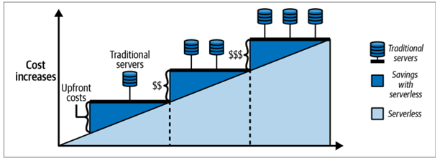
Why SERVERLESS?
Cost Efficiency: Pay only for actual usage; no costs for idle resources (consumption-based pricing).
Scalability: Automatically scales up or down based on demand.
Reduced Operational Overhead: No need to manage physical infrastructure or servers.
Focus on Code: Developers concentrate on coding rather than infrastructure management.

Slide 42
Azure Functions: The Core of Serverless Computing
Definition: Azure Functions is a serverless compute service that executes code in response to triggers.
Use Cases: Backend logic for APIs, integrations, event handling, data processing.
Event-Driven: Executes functions in response to events (HTTP requests, message queues, etc.).
Key Benefits:
Minimal code maintenance
Cost-effective (pay-as-you-go)
Flexibility in programming languages
Built-in autoscaling
Wide integration options with other Azure services

Slide 43
Components of Azure Functions
Triggers: Initiate function execution based on events (e.g., HTTP request, timer, queue message).
Example: HTTP Trigger, Timer Trigger, Blob Trigger.
Bindings: Connect input and output resources to the function.
Input Bindings: Receive data from a source (e.g., queue, blob storage).
Output Bindings: Send data to a destination (e.g., database, queue).
Direction Properties:
In: Data coming into the function.
Out: Data going out of the function.
InOut: Data both coming in and going out (for certain bindings).

Slide 44
Creating Azure Functions
Supported Languages: C#, Java, JavaScript, Python, TypeScript, PowerShell, etc.
Development Tools: Azure Portal, Visual Studio, Visual Studio Code.
Getting Started: Follow Microsoft’s guide for creating your first Azure Function.

Slide 45
Azure Durable Functions: Extending Serverless with Stateful Workflows
Definition: Extension of Azure Functions for creating stateful workflows and orchestration.
Purpose: Manage complex workflows with long-running operations and state management.
Benefits:
Automates business processes
Manages state and checkpoints
Reduces manual state management coding
Supports multiple languages (C#, JavaScript, Python, F#, PowerShell)

Slide 46
Features and Benefits of Azure Durable Functions
Stateful Workflows: Maintains state across function executions.
Complex Workflow Handling: Automate scenarios like approval workflows or waiting for external events.
Reduced Infrastructure Maintenance: Focus on developing logic instead of managing infrastructure.
Cost Efficiency: Pay only when function apps are running.
Integration Flexibility: Easily integrates with other Azure services and APIs.

Slide 47
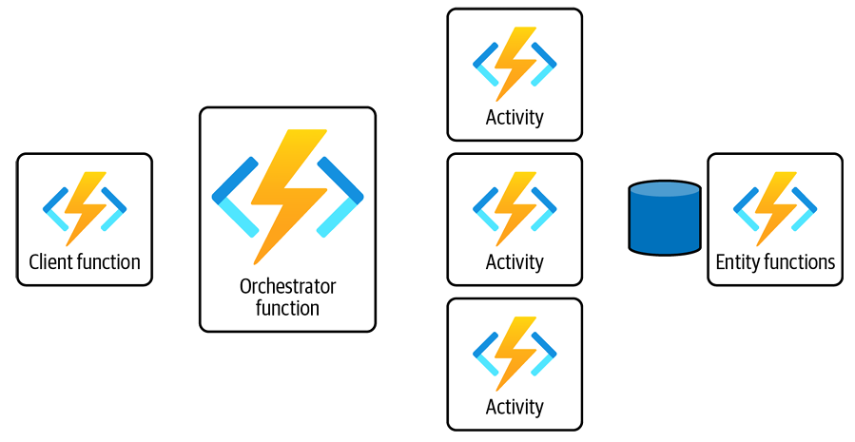
Components of Azure Durable Functions
Client Functions: Initiate the orchestration workflow. Example: HTTP-triggered client function.
Orchestrator Functions: Manage the execution and coordination of workflows. Example: Orchestrator function handling business logic.
Activity Functions: Perform individual tasks within workflows. Example: Functions performing data processing.
Entity Functions: Manage stateful entities within workflows. Example: Functions managing user states or session data.

Slide 48
Client Functions
Function: Start orchestration by triggering an orchestrator function.
Example: Triggered by HTTP, Blob storage, or Queue messages.
Example Code:
[FunctionName("BlobTriggerStart")]
public static async Task BlobTriggerClientFunction(
[BlobTrigger("photoscontainer/{name}", Connection ="StorageConnectionString")]
CloudBlockBlob myBlob, string name,
ILogger log, [DurableClient] IDurableOrchestrationClient starter)
{
// Function logic
}

Slide 49
Orchestrator Functions
Role: Defines the sequence of tasks and workflow.
Characteristics: Must be deterministic.
Tasks: Can include activity functions, sub-orchestrations, and external events.
Example Code:
[FunctionName("StorageOrchestrator")]
public static async Task<string> RunOrchestrator(
[OrchestrationTrigger] IDurableOrchestrationContext context, ILogger log)
{
// Function logic
}

Slide 50
Activity Functions
Role: Execute individual tasks within a workflow.
Characteristics: Short-lived and specific to a task.
Usage: Can run in parallel or sequentially.
Example Code:
[FunctionName("SendMessageToServiceBusQueue")]
public static async Task<string> SendMessageToAzureServiceBusQueueAsync(
[ActivityTrigger] CloudBlobItem uploadedBlob, ILogger log, ExecutionContext executionContext)
{
// Function logic
}

Slide 51
Entity Functions
Role: Manages stateful entities with persistence.
Characteristics: Encapsulates state and behavior in a class.
Usage: Handles entities like users, orders, or inventory.
Key Features:
Optimistic Concurrency Control: Ensures consistency across concurrent operations.
Durable State Management: Maintains and updates entity state reliably.

Slide 52
Developing Durable Functions
Define Client Functions: Trigger orchestration with a specific binding.
Implement Orchestrator Functions: Design workflows and handle business logic.
Create Activity Functions: Break down tasks and manage execution.
Manage Entity Functions: Handle stateful entities and ensure consistency.
Resources:
Microsoft Documentation on Azure Durable Functions
GitHub: Durable Task Framework

Slide 53
Common Patterns and Use Cases
Function Chaining: Sequence tasks in a specific order.
Fan-out/Fan-in: Execute tasks in parallel and aggregate results.
Human Interaction: Wait for external events like user input or approval.
Stateful Entities: Manage distributed stateful objects.
Examples:
Order Processing: Handle inventory checks, notifications, and shipments.
Approval Workflows: Automate processes requiring human intervention.

Slide 54
Uses and Benefits of Entity Functions
Scalability
Handles many concurrent requests
Scales dynamically to meet demand
Reliability
Durable state storage
Highly available and fault-tolerant
Consistency
Optimistic concurrency control
Ensures correct order of updates
Encapsulation
Encapsulates logic and state in a single class
Easier to maintain and evolve
Reusability
Can be used across multiple workflows
Reuse stateful entities in different parts of an application

Slide 55
Durable Function Types
Stateful: Orchestrator and Entity Functions
Stateless: Client and Activity Functions

Slide 56
Application Patterns: Function Chaining
Sequential execution of functions
Each function’s output is the next function’s input
[FunctionName("FunctionChainingExample")]
public static async Task<object> Run([OrchestrationTrigger] IDurableOrchestrationContext context)
{
var res1 = await context.CallActivityAsync<object>("myfunc1", null);
var res2 = await context.CallActivityAsync<object>("myfunc2", res1);
var finalresult = await context.CallActivityAsync<object>("myfunc3", res2);
return await context.CallActivityAsync<object>("myfunc4", finalresult);
}

Slide 57
Application Patterns: Fan-out/Fan-in
Executes multiple functions in parallel
Aggregates results
[FunctionName("FanOutFanInExample")]
public static async Task Run([OrchestrationTrigger] IDurableOrchestrationContext context)
{
var parallelTasks = new List<Task<int>>();
object[] workBatch = await context.CallActivityAsync<object[]>("F1", null);
for (int i = 0; i < workBatch.Length; i++)
{
Task<int> task = context.CallActivityAsync<int>("F2", workBatch[i]);
parallelTasks.Add(task);
}
await Task.WhenAll(parallelTasks);
int sum = parallelTasks.Sum(t => t.Result);
await context.CallActivityAsync("F3", sum);
}

Slide 58
Application Patterns: Async HTTP APIs
Handle long-running operations via HTTP
Redirect client to a status endpoint
[FunctionName("CheckWebsiteContentFunction")]
public static async Task CheckWebsite([OrchestrationTrigger] IDurableOrchestrationContext context, ILogger log)
{
Uri jonahsWebsite = new Uri("https://jonahandersson.tech");
DurableHttpResponse httpResponse = await context.CallHttpAsync(HttpMethod.Get, jonahsWebsite);
log.LogInformation($"Response Code: {httpResponse.StatusCode}");
log.LogInformation($"Content: {httpResponse.Content}");
}

Slide 59
Application Patterns: Monitor Pattern
Regular polling to check for conditions or job status
[FunctionName("MonitorCleanUpJobStatus")]
public static async Task Run([OrchestrationTrigger] IDurableOrchestrationContext context)
{
int cleanUpJobId = context.GetInput<int>();
int jobPollingInterval = GetPollingInterval();
DateTime expirationTime = GetExpiryTime();
string emailAddress = GetEmailAddress();
while (context.CurrentUtcDateTime < expirationTime)
{
var status = await context.CallActivityAsync<string>("GetJobCleanUp", cleanUpJobId);
if (status == "Completed")
{
await context.CallActivityAsync("SendMonitoringAlert", emailAddress);
break;
}
var nextMonitorCheck = context.CurrentUtcDateTime.AddSeconds(jobPollingInterval);
await context.CreateTimer(nextMonitorCheck, CancellationToken.None);
}
}

Slide 60
Application Patterns: Human Interaction
Handle processes requiring human input or approval
[FunctionName("ApprovalFromManagerWorkflow")]
public static async Task Run([OrchestrationTrigger] IDurableOrchestrationContext context)
{
await context.CallActivityAsync("RequestApprovalFromManager", null);
using (var timeout = new CancellationTokenSource())
{
DateTime dueTime = context.CurrentUtcDateTime.AddHours(72);
Task durableTimeout = context.CreateTimer(dueTime, timeout.Token);
Task<bool> humanInteractionEvent = context.WaitForExternalEvent<bool>("ManagerApprovalEvent");
if (humanInteractionEvent == await Task.WhenAny(humanInteractionEvent, durableTimeout))
{
timeout.Cancel();
await context.CallActivityAsync("ProcessRequest", humanInteractionEvent.Result);
}
else
{
await context.CallActivityAsync("EscalateToAnotherPerson", null);
}
}
}

Slide 61
Best Practices for Using Azure Functions and Durable Functions
Scalability: Design functions to handle varying loads and leverage autoscaling features.
Error Handling: Implement robust error handling and retry policies.
Monitoring and Logging: Use Azure Monitor and Application Insights for monitoring and debugging.
Security: Secure your functions with appropriate authentication and authorization.

Slide 62
Introduction to Container Services in Azure
Overview
Service for running containers in Azure without managing VMs
Ideal for quick deployment and isolation of applications
Advantages
Cost Savings: Lift-and-shift applications to the cloud without major changes
Development and CI/CD: Simplify development and continuous integration/continuous deployment
Integration: Seamless integration with Microsoft Entra ID for user access management and security

Slide 63
Azure Container Instances (ACI)
What is ACI?
Service for running containers in Azure without managing VMs
Ideal for quick deployment and isolation of applications
Key Features:
Dynamic Scaling: Scale containers up or down based on demand
Task Automation: Run and manage containerized tasks efficiently
Isolation: Containers run independently on shared or dedicated resources

Slide 64
Azure Kubernetes Service (AKS)
What is AKS?
Managed Kubernetes service for orchestrating containerized applications
Key Features:
Container Orchestration: Automated deployment, scaling, and management of containerized apps
Hybrid Deployment: Support for on-premises, cloud, and hybrid infrastructures
Security: Network security, role-based access control, and container isolation
CI/CD Integration: Works with Azure DevOps, GitHub, Jenkins, etc.
Monitoring & Auto-Scaling: Automated upgrades, self-healing, node auto-repair

Slide 65
Azure Container Registry (ACR)
What is ACR?
Managed service for storing and managing container images
Key Features:
RBAC (Role-Based Access Control): Control access to container images
Geo-Replication: Replicate container images across multiple Azure regions
Image Scanning: Scan for vulnerabilities and security issues
Deployment Best Practices:
Regional Deployment: Deploy ACR in the same region as your containers to reduce latency
Geo-Replication: Enable for improved availability and resiliency

Slide 66
Azure Container Apps (ACA)
Overview:
Serverless container service for building and deploying applications and microservices
Key Features:
Serverless Model: No need to manage underlying infrastructure
Built-In Authentication: Support for multiple identity providers (Microsoft Identity Platform, Google, Twitter, etc.)
Lifecycle Phases: Deployment, Update, Deactivation, Shutdown
Uses and Benefits:
Microservices: Develop and manage microservices applications
API Endpoints: Autoscale based on HTTP traffic
Background Processing: Run stateful and long-running jobs
Event-Driven Processing: Manage and autoscale event-driven tasks

Slide 67
Azure Quantum
What is Quantum Computing?
Utilizes quantum mechanics to solve complex problems faster than on classical computers
Applications:
Cryptography: Enhance security protocols
Mechanical Systems Simulation: Model complex systems
Machine Learning: Improve learning algorithms
Optimization Problems: Solve complex optimization tasks

Slide 68
Azure Quantum Platform
Overview:
Cloud service offering quantum solutions and technologies
Prepares for future quantum advancements
Key Components:
Azure Quantum Development Kit (Azure QDK): Develop with Q#, run on quantum hardware or optimization solvers
Q# Programming Language: Focused on quantum algorithm development
Learning Resources:
Microsoft Learning Path: Quantum Computing Foundations
Q# Community: Code examples, documentation, and community support

